Slide 1
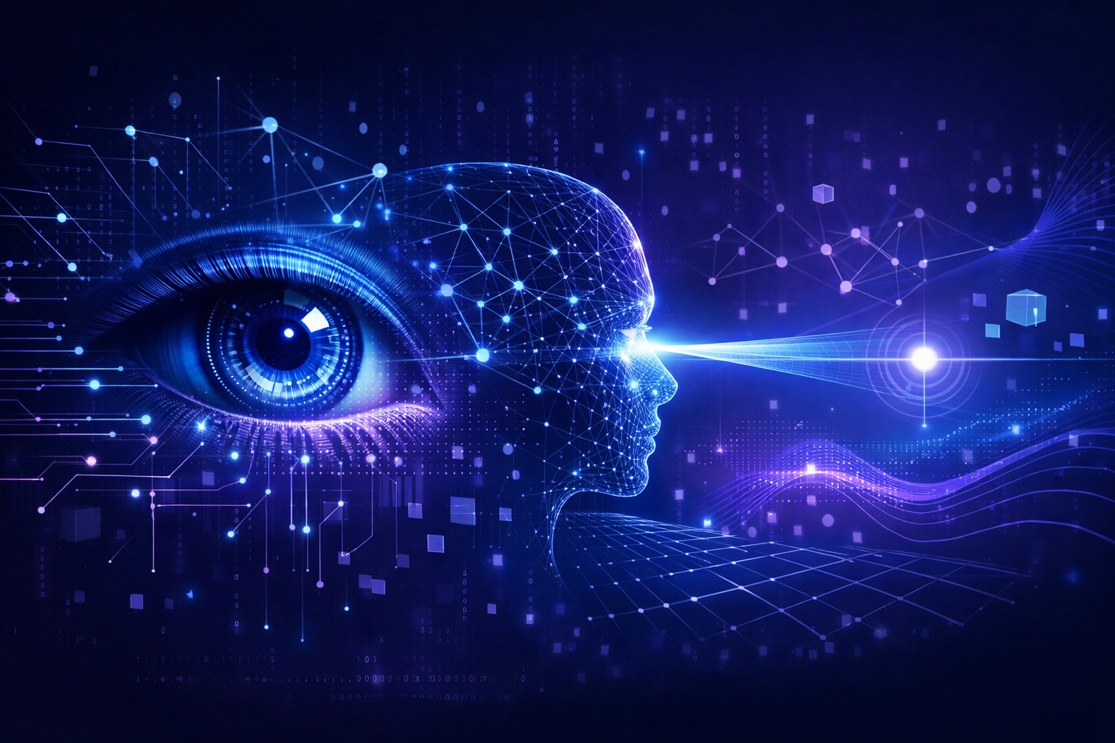
Eye Tracking & Gaze Estimation
AUS Lab II - Al Sarsar Al Kodmani Mousallam

Slide 2
Agenda
1
Pipeline overview
2
Camera calibration
3
Face detection (YOLOv8)
4
Gaze estimation (L2CS-Net)
5
Face landmarks & head pose
6
Iris gaze
7
Gaze fusion & Kalman filter
8
3D scene & depth
9
Live vs video modes
10
Applications & conclusion

Slide 3
Pipeline Overview
Input frame/video
Face detection
YOLOv8
Stable crop
Gaze prediction
(L2CS-Net)
Gaze fusion
3D scene
& depth
Face mesh
(Mediapipe)
Head pose
(solvePnP)
Iris gaze estimator
deapth
A multi-step pipeline combining deep learning, geometry, and filtering to estimate gaze and depth from video.

Slide 4
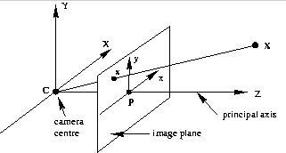
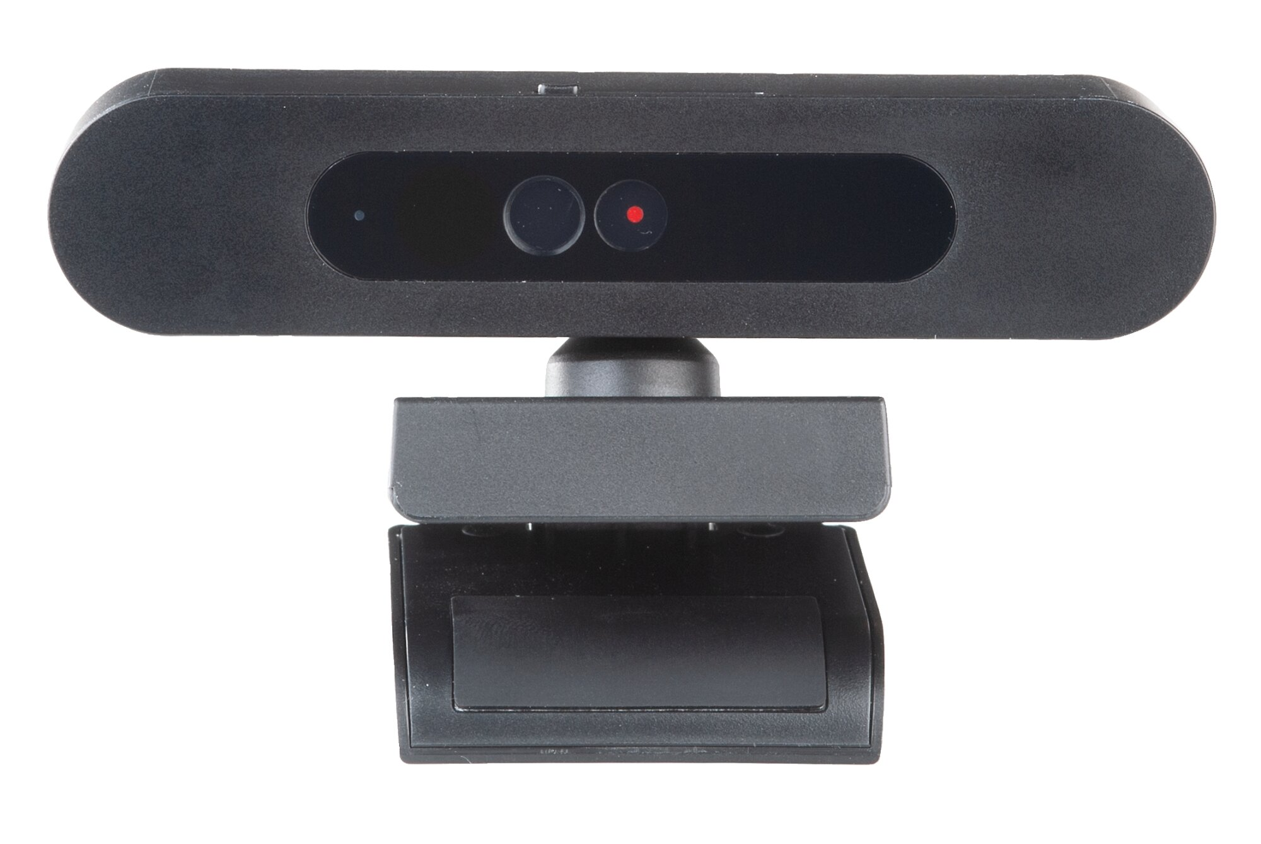
Camera Calibration
• Cameras exhibit radial and tangential distortions that warp images. • Calibration intrinsic parameters (focal lengths, principal point) and calculated from the camera infos. • the camera used is Lenovo 500 FHD Webcam.

Slide 5
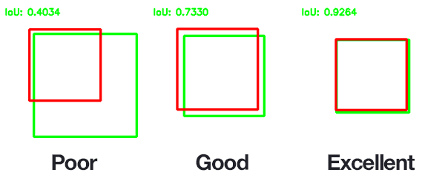
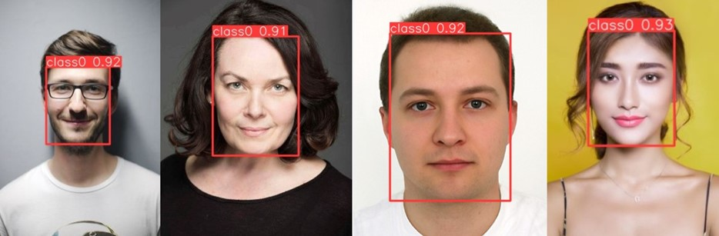
Face Detection – YOLOv8
• Uses advanced backbone and neck architectures for rich feature extraction. • Anchor‑free split head improves detection accuracy and reduces computation. • Optimised for real‑time performance, balancing speed and precision. • FaceDetector forms a union bounding box across frames to stabilise the crop.
Stable crop via union bounding box

Slide 6
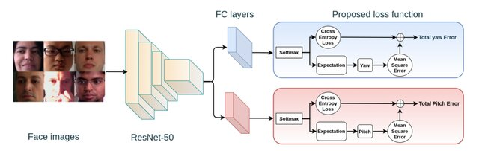
Gaze Estimation – L2CS‑Net
• ResNet‑50 backbone extracts feature maps from face crops. • Two parallel heads regress yaw and pitch separately. • Combined classification (discrete bins) and regression (MSE) losses increase precision. • Outputs coarse gaze angles (pitch, yaw) for each frame.

Slide 7
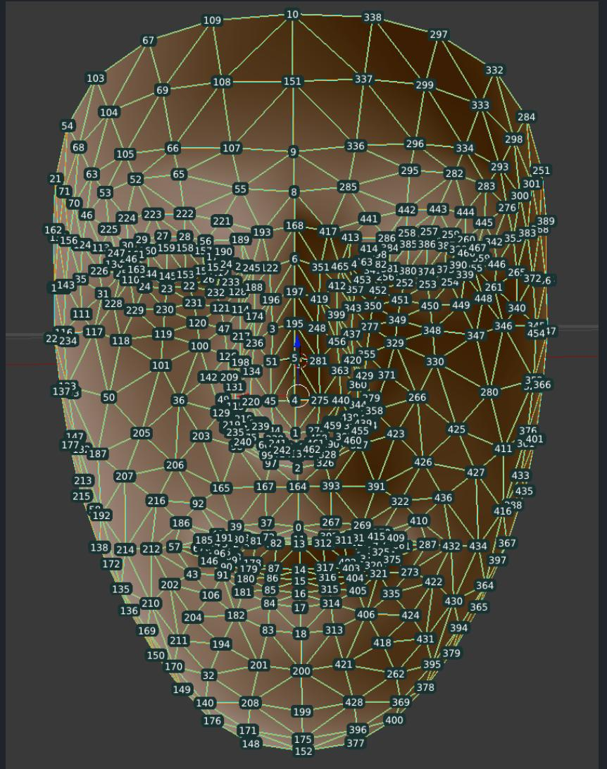
Face Landmarks – MediaPipe Face Mesh
• Predicts 468 three‑dimensional landmarks from a single camera in real time. • Utilises a face detector to crop the region and reduce the search space. • A Face Transform module recovers metric 3D space, enabling head pose estimation. • Returns full‑frame pixel coordinates for each landmark.
≈468 landmarks

Slide 8
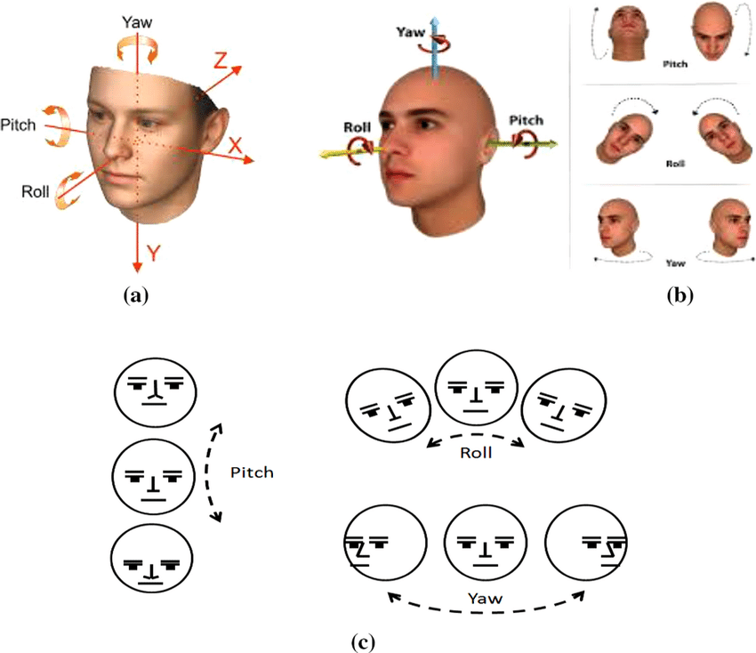
Head Pose – solvePnP
• Uses six 3D model points (nose, chin, eye & mouth corners) and their 2D projections. • solvePnP estimates rotation (rvec) and translation (tvec) given camera intrinsics. • rvec is converted to Euler angles (yaw, pitch, roll). • Coordinate axes: x→ right, y→ down, z→ forward into the scene.
Z
X
Y

Slide 9
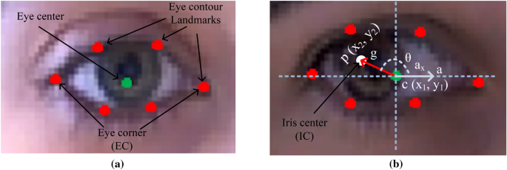
Iris Gaze Estimation
• Rotate the coordinate frame to remove head roll. • Threshold low‑intensity pixels in the eye region to localise the iris centre. • Compute the vector from eye centre to iris; derive amplitude and direction. • Combine left and right eyes to estimate vergence (where the two gaze rays meet).
gaze vector

Slide 10
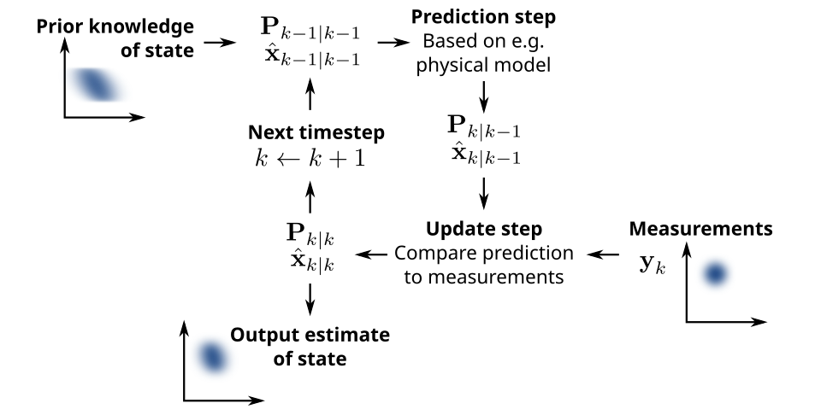
Gaze Fusion with Kalman Filter
• State vector: [x, y, noise], representing gaze point and its noise. • Prediction: propagate state using a constant‑velocity model and process noise. • Update: compute Kalman gain and blend measurement (iris & L2CS) with prediction. • Anchors the gaze vector at the eye or face centre; smooths jitter and handles missing measurements.

Slide 11
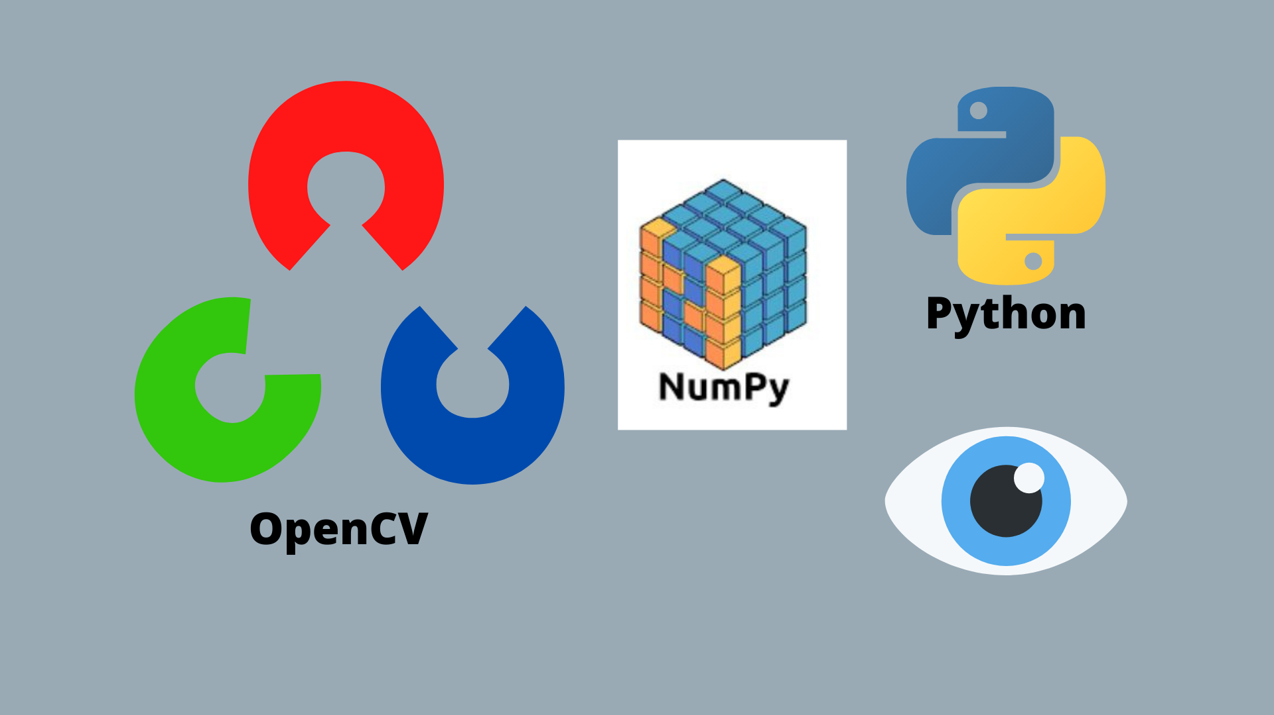
3D Scene & Depth Reconstruction
• Compute rotation matrix from yaw/pitch/roll and translate landmarks into camera space. • Project 3D points onto 2D using the pinhole camera model. • Use tvec to estimate head distance; smooth with a Kalman filter. • Render top & front views of the face and gaze vector for situational awareness.

Slide 12
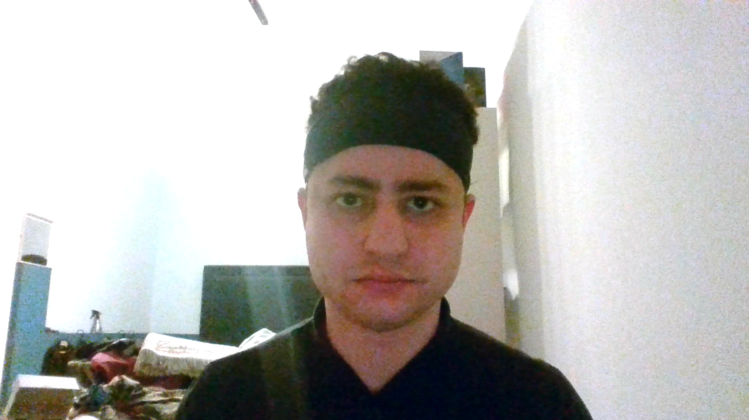
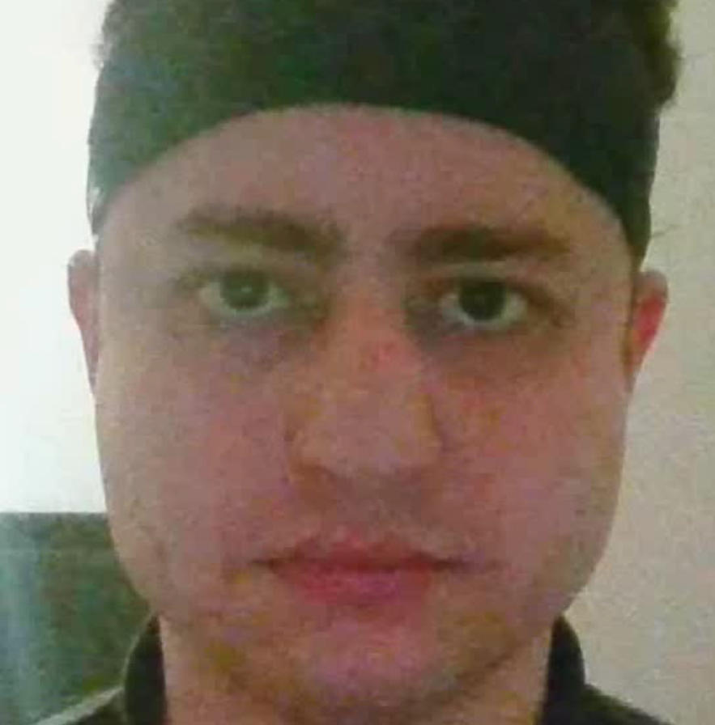
Results
Face Detection

Slide 13
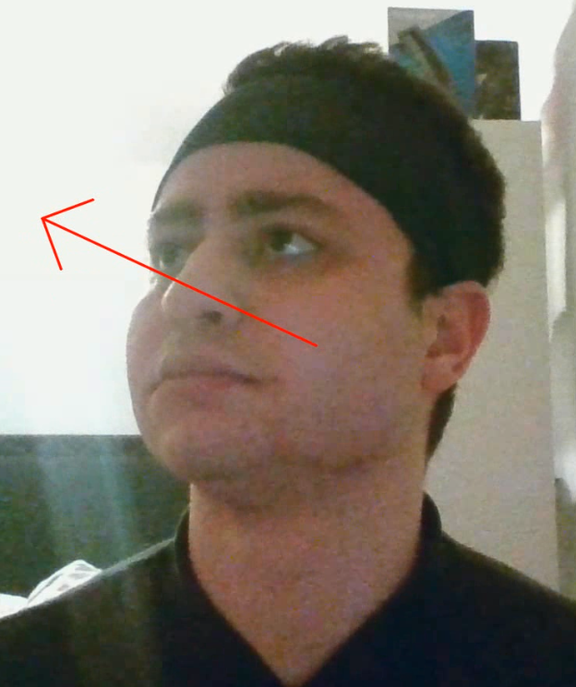
Results
L2CS-Net Gaze estimator

Slide 14
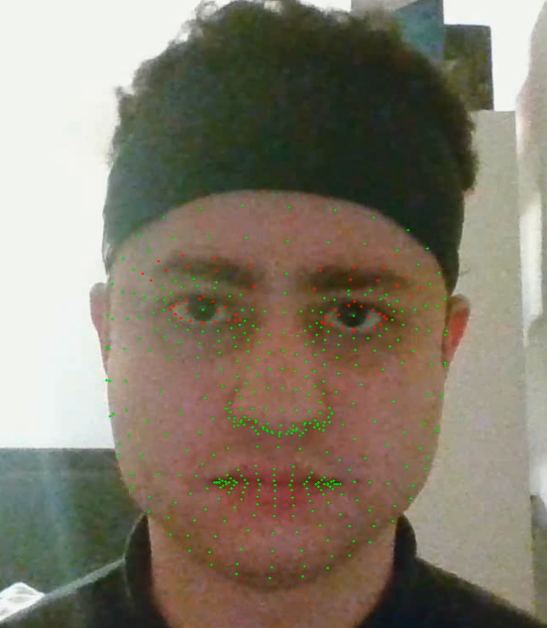
Results
Landmarks

Slide 15
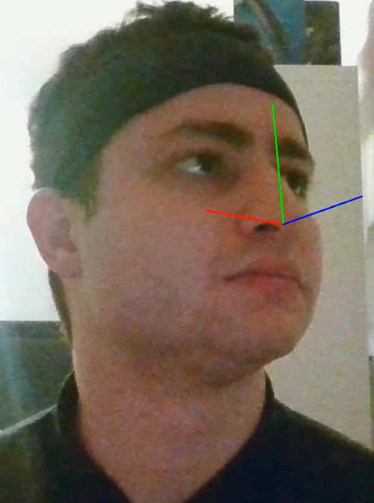
Results
Head pose (solvePnP)

Slide 16
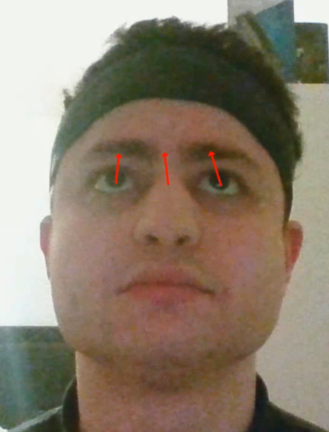
Results
Iris gaze estimator

Slide 17
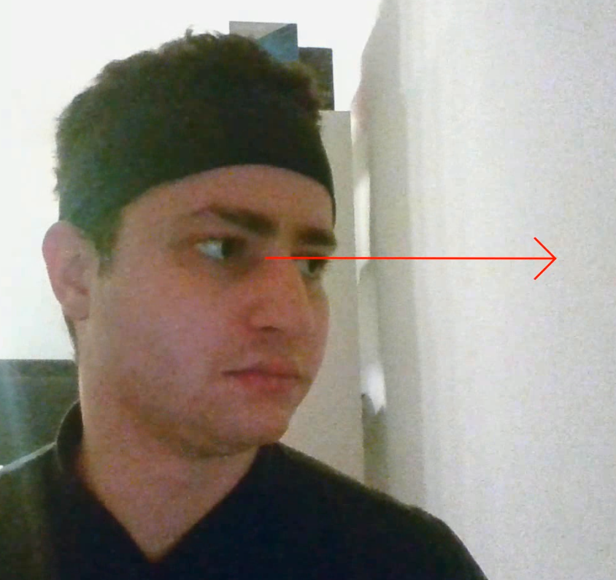
Results
Fusion using Kalman Filter

Slide 18
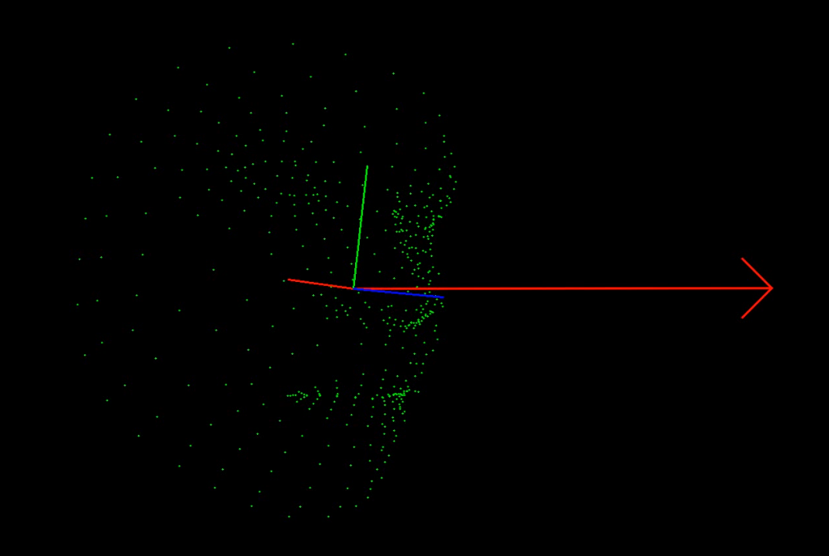
Results
3D scene and Depth Estimator

Slide 19


Live Mode vs Video Mode
Live (Webcam) –flag 0 • Process frames in real time. • Union box updated dynamically for cropping. • Head distance & gaze fused per frame with Kalman smoothing. • Render 3D scene overlay for instant feedback.
Video Input —flag x • Pre-compute union bounding box for the entire clip. • Process each frame sequentially without real-time constraints. • Allows offline analysis and visualisation. • The same pipeline components are executed as in live mode.

Slide 20



Applications & Use Cases
Driver monitoring (ADAS) • Tracks gaze to detect distraction; reduces accidents by 10–20% • Supports autonomous handover by checking driver attention
Industry & Manufacturing • Monitors operators’ focus during sensitive tasks • Enables safety systems to pause machines if gaze deviates
Human–Computer Interaction • Enables hands‑free control for VR/AR and accessibility • Collects gaze analytics for marketing & UX studies

Slide 21
Conclusion & Future Directions
• Integrated pipeline combines state‑of‑the‑art detection, landmarking, geometry and filtering for accurate gaze estimation. • Fusion of (L2CS) and (iris) gaze estimator using Kalman filtering yields robust results in noise. • 3D scene rendering provides intuitive feedback on head pose and gaze direction. • Future work: Adopt larger gaze networks, integrate multi‑view cameras.

Slide 22
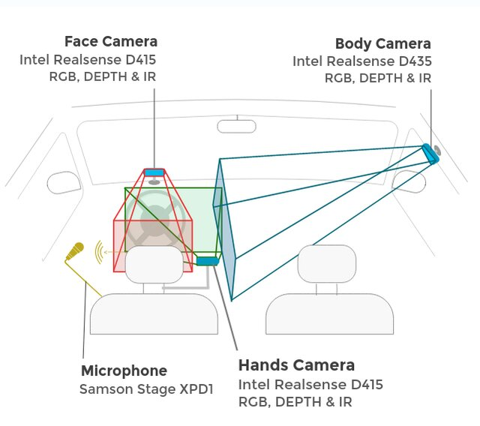
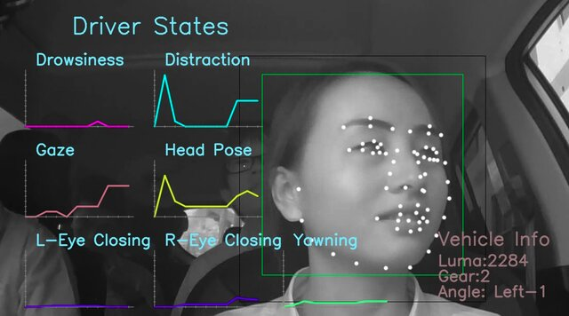
Conclusion & Future Directions
Thank you!

